Slide 1

Stability, Fairness and the Pursuit of Happiness*
Gerdus Benadè
Nachiketa Sahoo
*In recommender systems
Notes:
18 total, ~15+3
recommender systems, ubiquitous, use them daily
"recommender systems learn individuals' preferences and match to each, usually top-k, products that each would like". Expose us to new choices + Shape our and preferences often without explicitly realizing what is happening
I want to begin by asking you to consider a simple question about these recommender systems we interact with every day

Slide 2
Are markets using
personalized recommender systems stable?
Notes:
Would buyers and sellers, if they had complete information about other actors in the market, buyer preferences and item availabilities, continue participating in a market.
Or will they have incentives to break from the match, start pursuing off platform transaction?
STABILITY matching literature: called stable, no incentive to deviate from the match
Interesting – relationship between buyers and sellers is precariously balanced

Slide 3


Are recommender system markets stable?
Without exposure constraints – information goods
Top-$k$ recommendations are stable, envy-free and welfare optimal
With exposure constraints – physical goods, ad contracts
Stable recommendations need not exist
Maximizing buyer welfare
Provably stable sometimes, small incentive for sellers to deviate in experiments
Notes:
If you only remember one slide:: this is the one
Digital goods: ebooks, movies, music on spotify – no constraint on number of plays
Broader: buyers with orthogonal preferences
Physical goods – capacities/restaurants, stockouts
Rest of talk – filling out details and giving some intuition

Slide 4
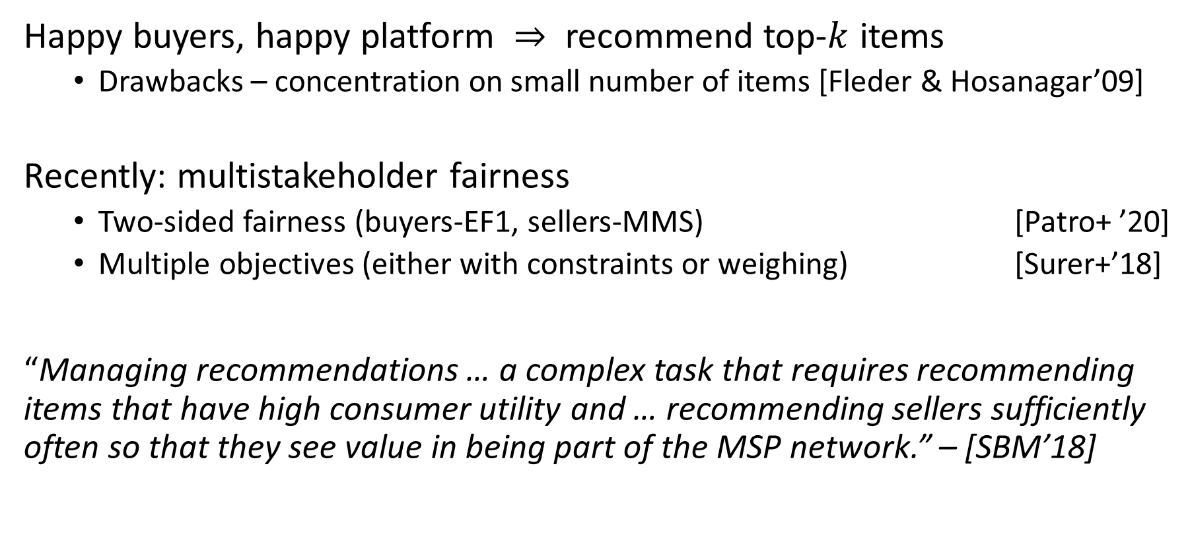
Recommender systems literature
Happy buyers, happy platform $⇒$ recommend top-$k$ items
Drawbacks – concentration on small number of items [Fleder & Hosanagar’09]
Recently: multistakeholder fairness
Two-sided fairness (buyers-EF1, sellers-MMS) [Patro+ ’20]
Multiple objectives (either with constraints or weighing) [Surer+’18]
“Managing recommendations … a complex task that requires recommending items that have high consumer utility and … recommending sellers sufficiently often so that they see value in being part of the MSP network.” – [SBM’18]
Notes:
Just read quote
SBM – Surer, Burke, Malthouse (Multistakeholder Recommendation with Provider Constraints Özge)

Slide 5
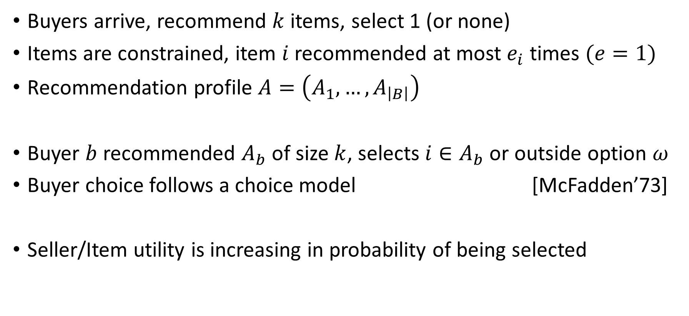
Model for batch recommendations
Buyers arrive, recommend $k$ items, select 1 (or none)
Items are constrained, item $i$recommended at most $e_{i}$ times $(e=1)$
Recommendation profile $A=\left(A_{1},…, A_{\left|B\right|}\right)$
Buyer $b$ recommended $A_{b}$ of size $k$, selects ${i∈A}_{b}$ or outside option $ω$
Buyer choice follows a choice model [McFadden’73]
Seller/Item utility is increasing in probability of being selected
Notes:
we model our problem after typical recommender systems on e-commerce platforms where an RS recommends k items to an arrive customer from which a customer usually selects one

Slide 6
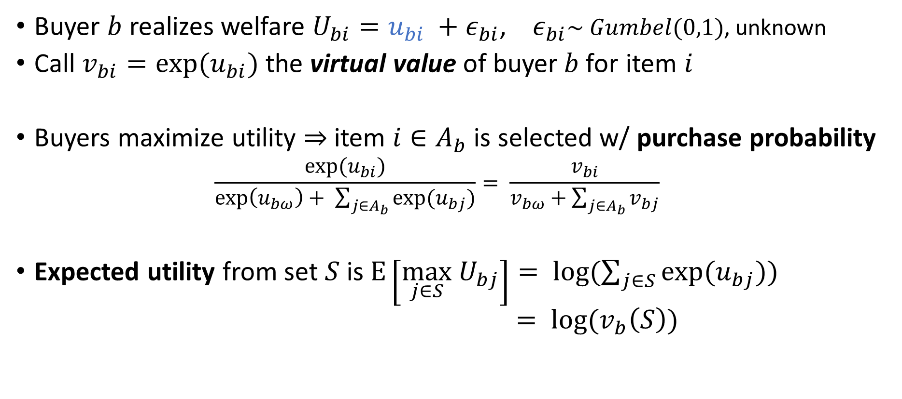
Buyer behavior follows a choice model
[McFadden’73]
Buyer $b$ realizes welfare $U_{bi}=u_{bi} +ε_{bi}$, $ε_{bi}\sim Gumbel(0,1)$, unknown
Call $v_{bi}=exp⁡(u_{bi})$ the virtual value of buyer$b$for item $i$
Buyers maximize utility $⇒$item $i∈A_{b}$ is selected w/ purchase probability
$$\frac{\exp{{(u}_{bi})}}{\exp\left(u_{bω}\right)+ \sum_{j∈A_{b}}{\exp{(u_{bj})}}}= \frac{v_{bi}}{v_{bω}+\sum_{j∈A_{b}}{v_{bj}}}$$
Expected utility from set $S$is$E\left[\max_{j∈S} U_{bj}\right]= \log{(\sum_{j∈S}{\exp{(u_{bj})})}}$
$= \log{(v_{b}\left(S\right))}$
Better choice sets: Good for buyers, bad for sellers
item value
competition in choice set
outside option
Notes:
u_bi – known to us, epsilon unknown to us, realized by the buyer when considering item
Gumbel mean 0 beta 1 = extreme value type 1 F(x) = exp(-exp(-s))
Models distribution of maxima of multiple samples from a distribution.
Random choice – randomness in the uncertainty of the valuation
PO in terms of virtual values also PO in terms of wefare
Notice that seller prob(utility) decreases in competition

Slide 7
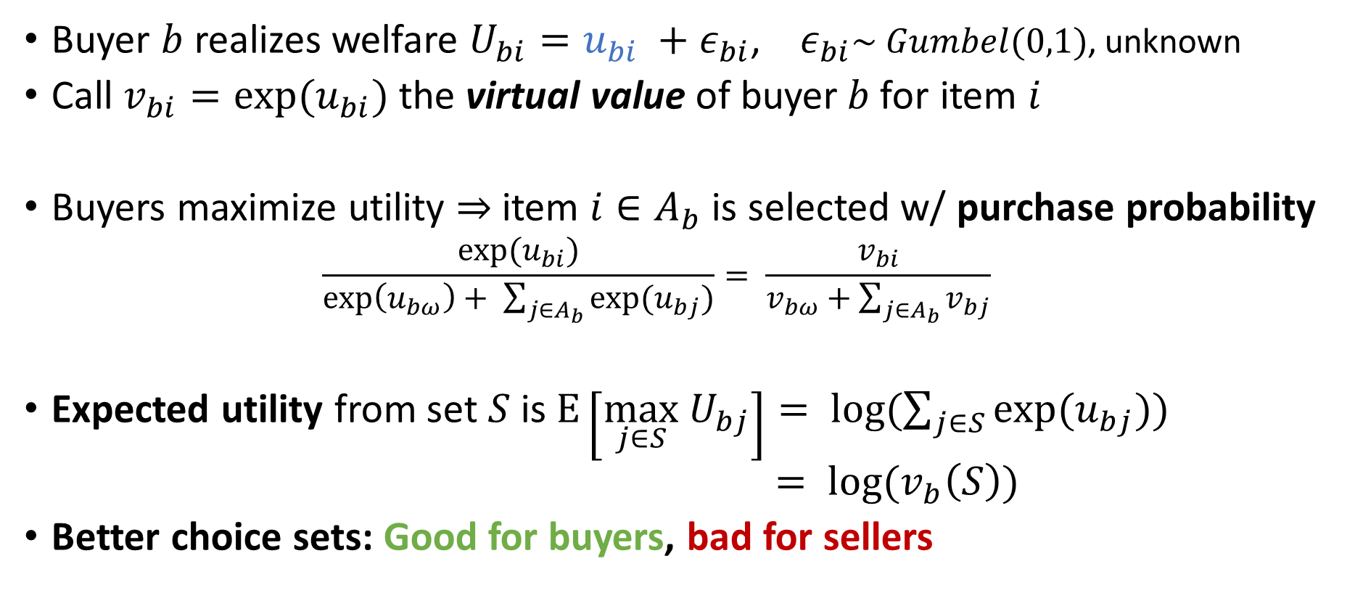
Buyer behavior follows a choice model
[McFadden’73]
Buyer $b$ realizes welfare $U_{bi}=u_{bi} +ε_{bi}$, $ε_{bi}\sim Gumbel(0,1)$, unknown
Call $v_{bi}=exp⁡(u_{bi})$ the virtual value of buyer$b$for item $i$
Buyers maximize utility $⇒$item $i∈A_{b}$ is selected w/ purchase probability
$$\frac{\exp{{(u}_{bi})}}{\exp\left(u_{bω}\right)+ \sum_{j∈A_{b}}{\exp{(u_{bj})}}}= \frac{v_{bi}}{v_{bω}+\sum_{j∈A_{b}}{v_{bj}}}$$
Expected utility from set $S$is$E\left[\max_{j∈S} U_{bj}\right]= \log{(\sum_{j∈S}{\exp{(u_{bj})})}}$
$= \log{(v_{b}\left(S\right))}$
Better choice sets: Good for buyers, bad for sellers
Notes:
PO in terms of virtual values also PO in terms of wefare
Notice that seller prob(utility) decreases in competition

Slide 8
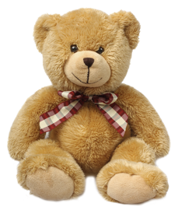
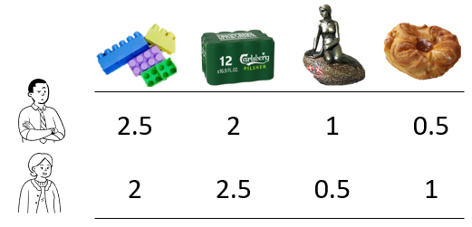
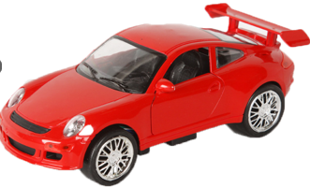



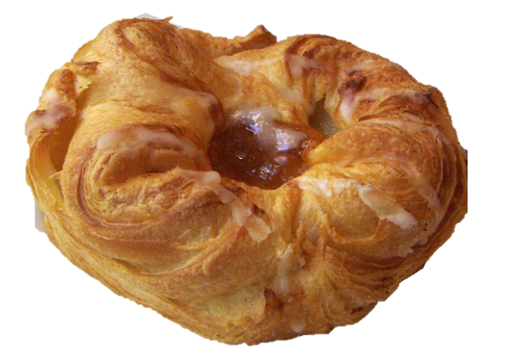


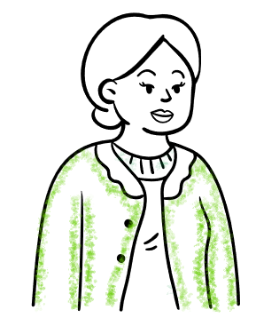

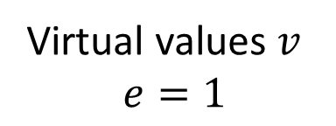

Example: Buy a gift
Preference orders
: , , ,
: ( , ), ( , ), ( , ), ( , ), … , ( , )
Virtual values $v$
$$e=1$$
$\frac{2.5}{3}=\frac{5}{6}$ $\frac{2}{2.5}=0.8$ $\frac{2.5}{3.5}=0.71$ $\frac{2}{3}=0.66$ $\frac{2}{4.5}=0.44$
Notes:
Deferred acceptance schemes typically conditionally accept someone until someone better comes along
Here doesn’t work, you don’t know if you like them yet
Preference order over (buyer, bundle) not buyers.
Assuming outside option has virtual value 0 : whatever the outside option’s value is it remains true

Slide 9
Matching literature
Offline markets unravel in absence of stability (interns, schools) [Roth’84,’15]
Many-many/Many-one matchings (hospitals-residents/workers-firms)
Substitutability/worker preferences depend only on firms: sufficient for stability [Kelso & Crawford’82]
Notes:
Is stability really required? Schools/Hospitals. Offline markets unravel – search + discovery is expensive, deviation is hard. much easier in online markets
Substitutability – if x in choice set (contracts) of options A, then x should still be in the choice set after removing something else from A. Different versions of substitutes in various settings - all around same idea, if you accept, then you accept with fewe options/reject -> reject with more options
- OURS – very much depends on other items in the choice set

Slide 10
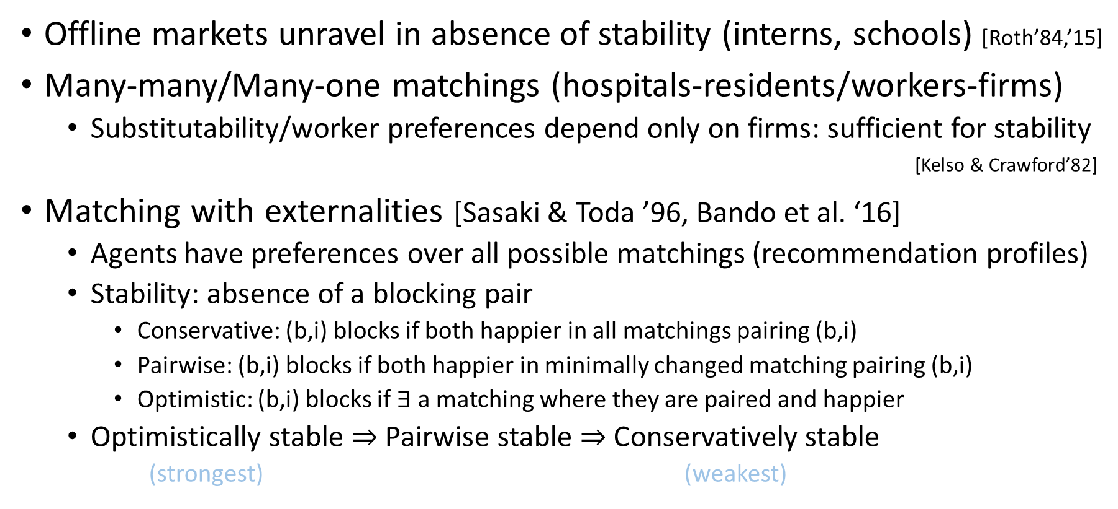
Matching literature
Offline markets unravel in absence of stability (interns, schools) [Roth’84,’15]
Many-many/Many-one matchings (hospitals-residents/workers-firms)
Substitutability/worker preferences depend only on firms: sufficient for stability [Kelso & Crawford’82]
Matching with externalities [Sasaki & Toda ’96, Bando et al. ‘16]
Agents have preferences over all possible matchings (recommendation profiles)
Stability: absence of a blocking pair
Conservative: (b,i) blocks if both happier in all matchings pairing (b,i)
Pairwise: (b,i) blocks if both happier in minimally changed matching pairing (b,i)
Optimistic: (b,i) blocks if $∃$a matching where they are paired and happier
Optimistically stable $⇒$ Pairwise stable $⇒$Conservatively stable
(strongest) (weakest)
Guaranteed using DA
We study this
Notes:
Is stability really required? Schools/Hospitals. Offline markets unravel – search + discovery is expensive, deviation is hard. much easier in online markets
Substitutability – if x in choice set (contracts) of options A, then x should still be in the choice set after removing something else from A. Different versions of substitutes in various settings - all around same idea, if you accept, then you accept with fewe options/reject -> reject with more options
- OURS – very much depends on other items in the choice set

Slide 11
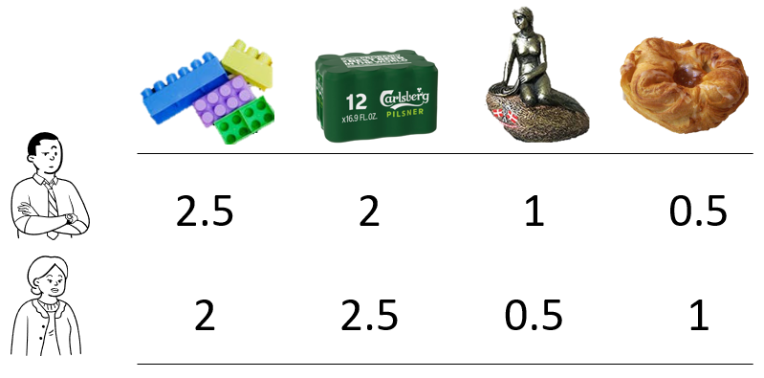
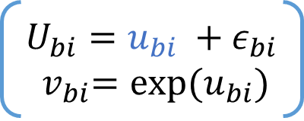
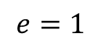
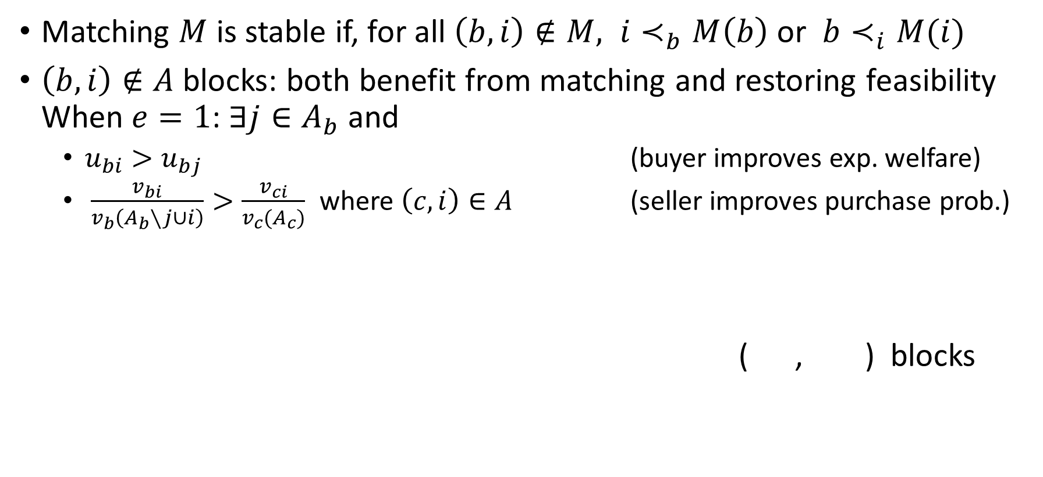
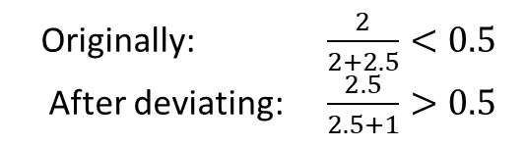
Ex-ante stability
$U_{bi}=u_{bi} +ε_{bi}$ ${ v}_{bi}=exp⁡(u_{bi})$
Matching $M$ is stable if, for all $\left(b,i\right)∉M, i≺_{b}M\left(b\right)$ or $b≺_{i}M(i)$
$\left(b,i\right)∉A$ blocks: both benefit from matching and restoring feasibility When $e=1$: $∃j∈A_{b}$ and
$u_{bi}>u_{bj}$ (buyer improves exp. welfare)
$\frac{v_{bi}}{v_{b}\left(A_{b}∖j∪i\right)}>\frac{v_{ci}}{v_{c}(A_{c})}$ where $\left(c,i\right)∈A$ (seller improves purchase prob.)
( , ) blocks
prob when deviating > original prob
$$e=1$$
Originally: $\frac{2}{2+2.5}<0.5$
After deviating: $\frac{2.5}{2.5+1}>0.5$
Notes:
Focus only on the example
General: require that it is possible to feasibliy complete the recommendation – equiv assume a number of dummy items of lowest value available. Sometimes seen it called feasibly stable
Using the known components – stable in expectation

Slide 12
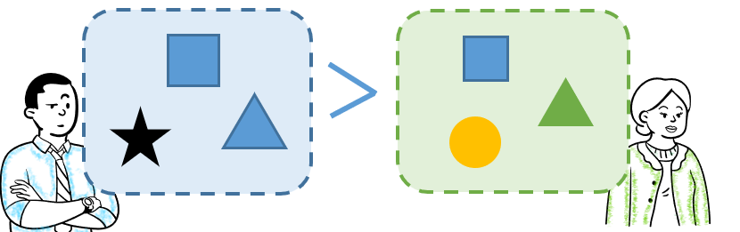
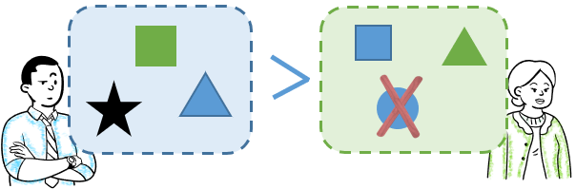
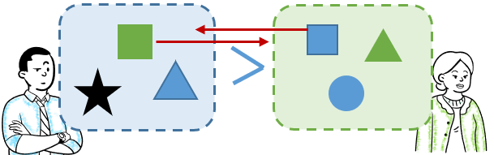
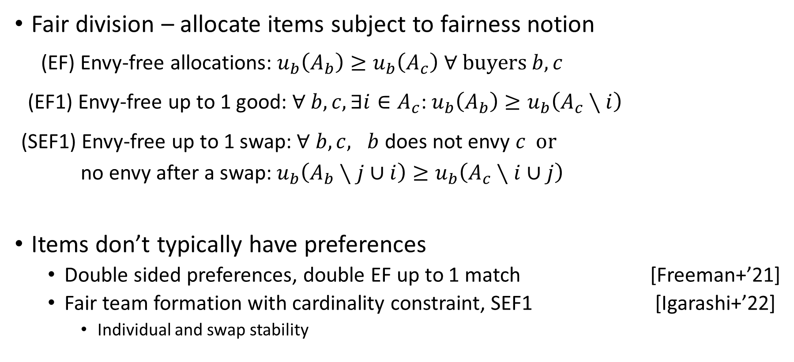
Constrained recommendations as fair assignments
EF
Fair division – allocate items subject to fairness notion
(EF) Envy-free allocations: $u_{b}\left(A_{b}\right)≥u_{b}\left(A_{c}\right) ∀ buyers b,c$
(EF1) Envy-free up to 1 good: $∀ b,c, ∃i∈A_{c}$: $u_{b}\left(A_{b}\right)≥u_{b}\left(A_{c}∖i\right)$
(SEF1) Envy-free up to 1 swap: $∀ b,c, b$ does not envy $c$ or
no envy after a swap:$u_{b}\left(A_{b}∖j∪i\right)≥u_{b}\left(A_{c}∖i∪j\right)$
Items don’t typically have preferences
Double sided preferences, double EF up to 1 match [Freeman+’21]
Fair team formation with cardinality constraint, SEF1 [Igarashi+’22]
Individual and swap stability
EF1
SEF1
Notes:
Freeman, Misha, Shah – for identical preferences a version of round robin is double EF1
Igarashi – Sef1
Swap stability – no swap makes at least 1 party better off, others no worse
Individual stability – no swap makes player better off, neither team worse off

Slide 13
Can we guarantee stable, fair and efficient recommendations?
Are markets using personalized
recommender systems stable?
Notes:
In batches
Stability – both buyers and sellers
Fairness – EF/SEF1 on buyer side
Efficient – PO on buyer side

Slide 14
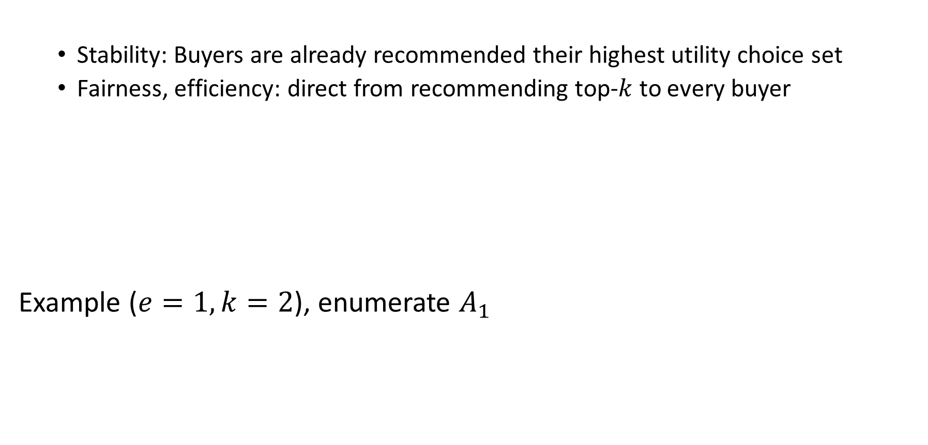
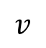
Loose exposure constraints – e.g. information goods
Top-$k$ recommendations are stable, envy-free and welfare optimal
Stability: Buyers are already recommended their highest utility choice set
Fairness, efficiency: direct from recommending top-$k$ to every buyer
Example ($e=1,k=2$), enumerate $A_{1}$
Tight exposure constraints – physical goods, ad contracts
Stable recommendations need not exist
 | A | B | C | D
1 | 10 | 1 | 7 | 6
2 | 10 | 8 | 4 | 5
$$v$$
Notes:
Whenever the capacity constraints are irrelevant – top k is good. Digital/information goods – movies/music etc
To the best of our knowledge hasn’t been observed before. Top-ks are common, turn out they trivially) are stable, which says something about seller satisfaction too.
Example is quite flexible – can construct similar example where factorized. Also for identical order.

Slide 15
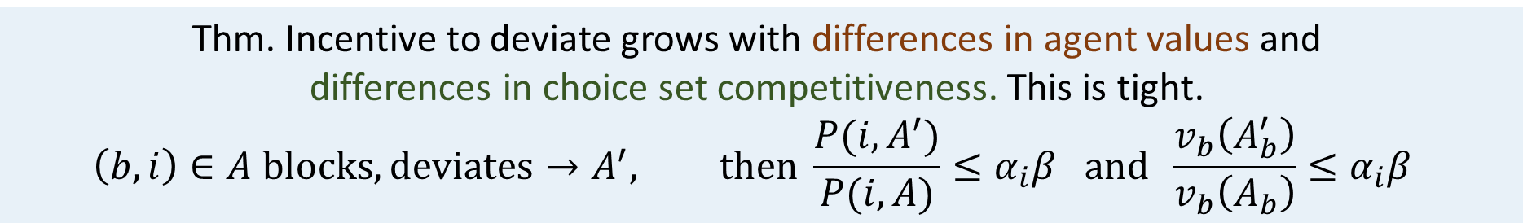
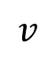
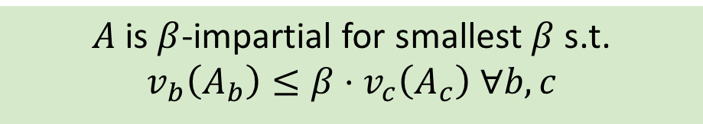
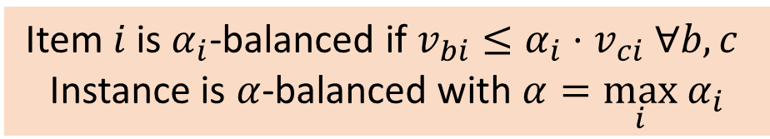
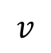
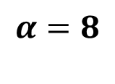
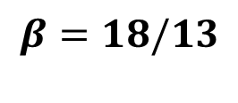
Bounding incentive to deviate
 | A | B | C | D
1 | 10 | 1 | 7 | 6
2 | 10 | 8 | 4 | 5
 | A | B | C | D
1 | 10 | 1 | 7 | 6
2 | 10 | 8 | 4 | 5
$$v$$
$$v$$
$$α=8$$
$$β=18/13$$
Item $i$ is $α_{i}$-balanced if $v_{bi}≤α_{i}⋅v_{ci} ∀b, c$
Instance is $α$-balanced with $α=\max_{i} α_{i}$
$A$ is $β$-impartial for smallest $β$ s.t. $v_{b}\left(A_{b}\right)≤β⋅v_{c}\left(A_{c}\right) ∀b,c$
Thm. Incentive to deviate grows with differences in agent values and
differences in choice set competitiveness. This is tight.
$$\left(b,i\right)∈A blocks, deviates→A^{′}, then \frac{P(i, A^{′})}{P(i, A)}≤α_{i}β and \frac{v_{b}\left(A_{b}^{′}\right)}{v_{b}\left(A_{b}\right)}≤α_{i}β$$

Slide 16
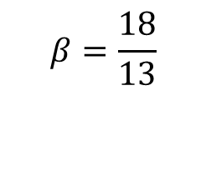
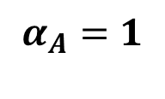
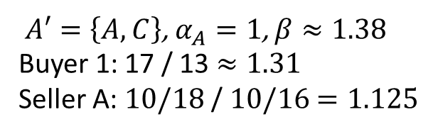
Bounding incentive to deviate
$A′=\left\{A, C\right\}$, $α_{A}=1$, $β≈1.38$
Buyer 1: 17 / 13 $≈1.31$
Seller A: $10/18$ / $10/16$ $=1.125$
 | A | B | C | D
1 | 10 | 1 | 7 | 6
2 | 10 | 8 | 4 | 5
 | A | B | C | D
1 | 10 | 1 | 7 | 6
2 | 10 | 8 | 4 | 5
$$v$$
$$v$$
$$β=\frac{18}{13}$$
$$α_{A}=1$$
Item $i$ is $α_{i}$-balanced if $v_{bi}≤α_{i}⋅v_{ci} ∀b, c$
Instance is $α$-balanced with $α=\max_{i} α_{i}$
$A$ is $β$-impartial for smallest $β$ s.t. $v_{b}\left(A_{b}\right)≤β⋅v_{c}\left(A_{c}\right) ∀b,c$
Thm. Incentive to deviate grows with differences in agent values and
differences in choice set competitiveness. This is tight.
$$\left(b,i\right)∈A blocks, deviates→A^{′}, then \frac{P(i, A^{′})}{P(i, A)}≤α_{i}β and \frac{v_{b}\left(A_{b}^{′}\right)}{v_{b}\left(A_{b}\right)}≤α_{i}β$$
Notes:
Gives us a way to aim for stability – impartial alloactions

Slide 17
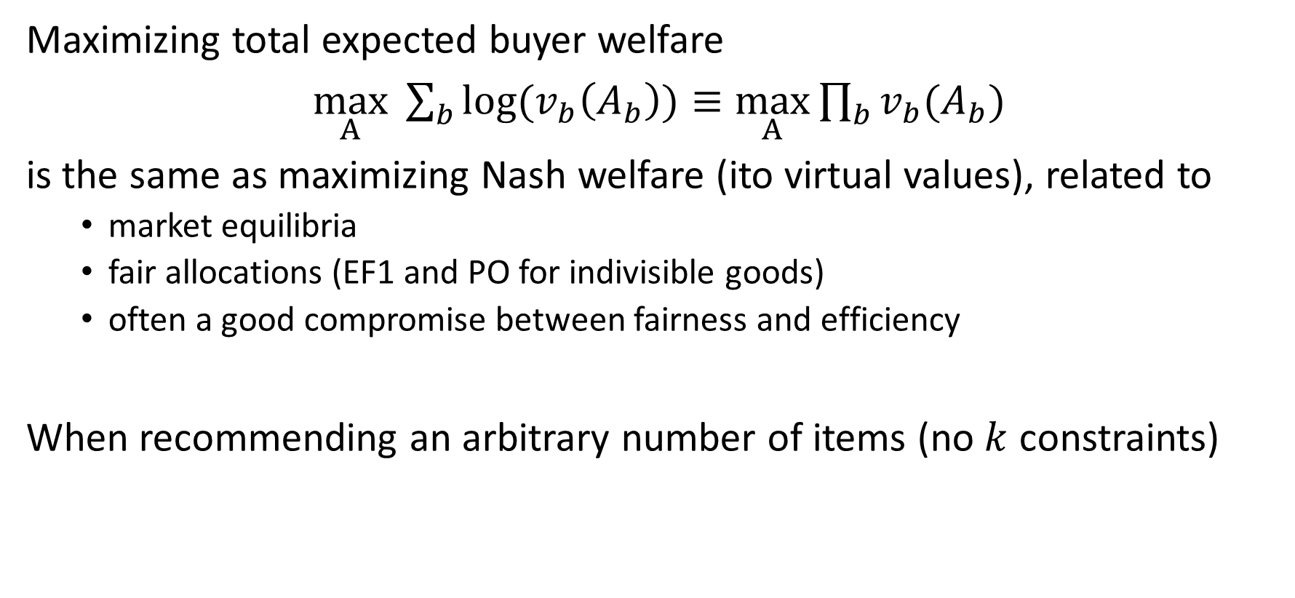
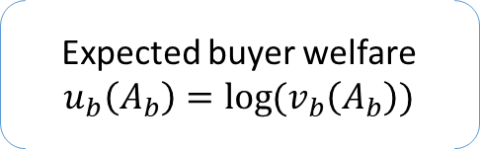
Maximizing buyer welfare
Expected buyer welfare $u_{b}\left(A_{b}\right)=\log{(v_{b}\left(A_{b}\right))}$
Maximizing total expected buyer welfare
$\max_{A} \sum_{b}{\log{(v_{b}\left(A_{b}\right))}}≡\max_{A}\prod_{b}{v_{b}(A_{b})}$
is the same as maximizing Nash welfare (ito virtual values), related to
market equilibria
fair allocations (EF1 and PO for indivisible goods)
often a good compromise between fairness and efficiency
When recommending an arbitrary number of items (no $k$ constraints)
Theorem. The unconstrained recommendation profile
that maximizes buyer welfare is stable and PO
Notes:
MNW is ef1, PO from fair division literature
Related to Fisher market equilibria in the divisible case
- show closely related to stability here
Related to market equilibria in the divisible case

Slide 18
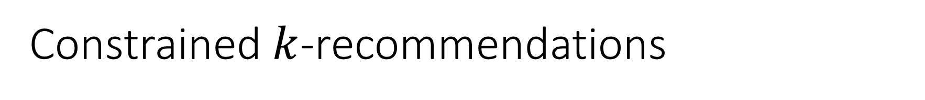
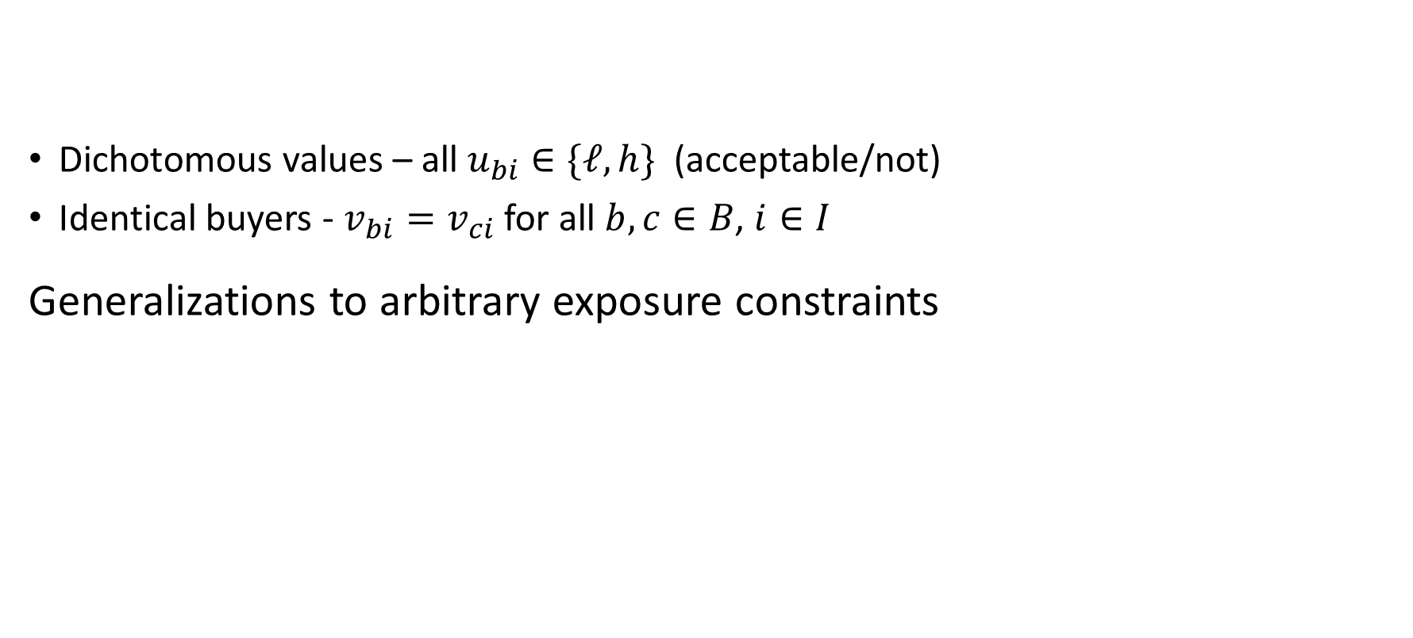
Constrained $k$-recommendations
Dichotomous values – all $u_{bi}∈\{ℓ,h\}$ (acceptable/not)
Identical buyers - $v_{bi}=v_{ci}$ for all $b,c∈B$, $i∈I$
Generalizations to arbitrary exposure constraints
Thm. For unit exposure constraints and identical buyers or dichotomous values, maximizing expected buyer welfare is stable, swap-envyfree and Pareto optimal
Thm. For identical buyers and general exposure constraints,
maximizing expected buyer welfare is SEF1 and PO
Thm. For dichotomous buyers and general exposure constraints,
maximizing expected buyer welfare is stable and PO

Slide 19
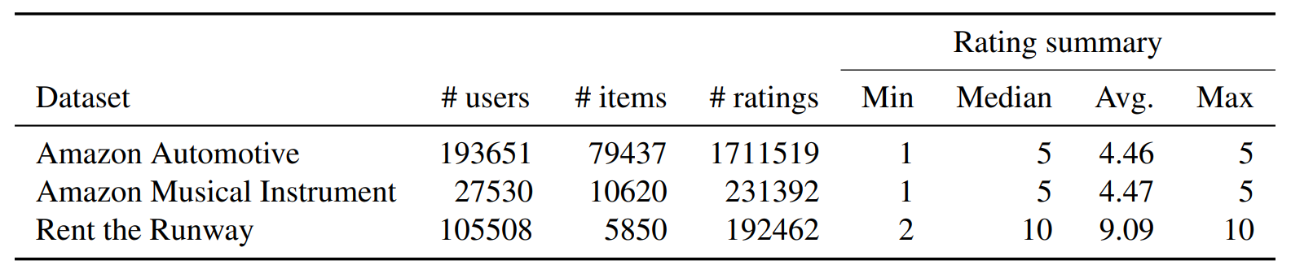
Stability in practical settings
Data from two real-world settings with capacity constraints
Rent-the-runway: clothing rental
Two Amazon categories: musical instruments, automotive
Experiment: Estimate values with standard collaborative filtering alg (SVD++), sample users and items, produce 5-recommendation, evaluate.
Notes:
Easure instability in real data – is there really a risk of the market unravelling?
RtR – in the process of becoming a platform – allowing others to manage inventory and making recommendations

Slide 20
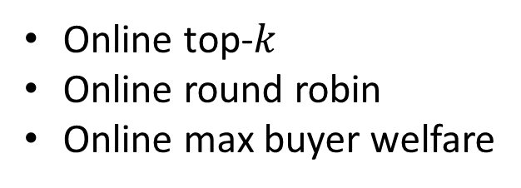
Algorithms and metrics
Heuristic algorithms
Round robin (SEF1)
Maximizing buyer welfare
Metrics
Welfare – avg. buyer welfare
Move – % of sellers who participate in at least one blocking pair
Gain – avg. of sellers highest relative gain in purchase probability (if blocking)
Envy – % of buyers who have pairwise envy
Swap envy – % of buyers who have swap envy up to 1 swap
Online top-$k$
Online round robin
Online max buyer welfare
(batch) (online)
Notes:
All algs satisfy respect exposure constraints
RR – always SEF1 - straightforward
Max welfare – no guarantee to have any nice properties here, not even to find stable match on instances where it exists.
Online versions: see buyers one at a time, recommend before seeing the rest of the instance
RR/MW – sample remainder of instance from past buyers

Slide 21
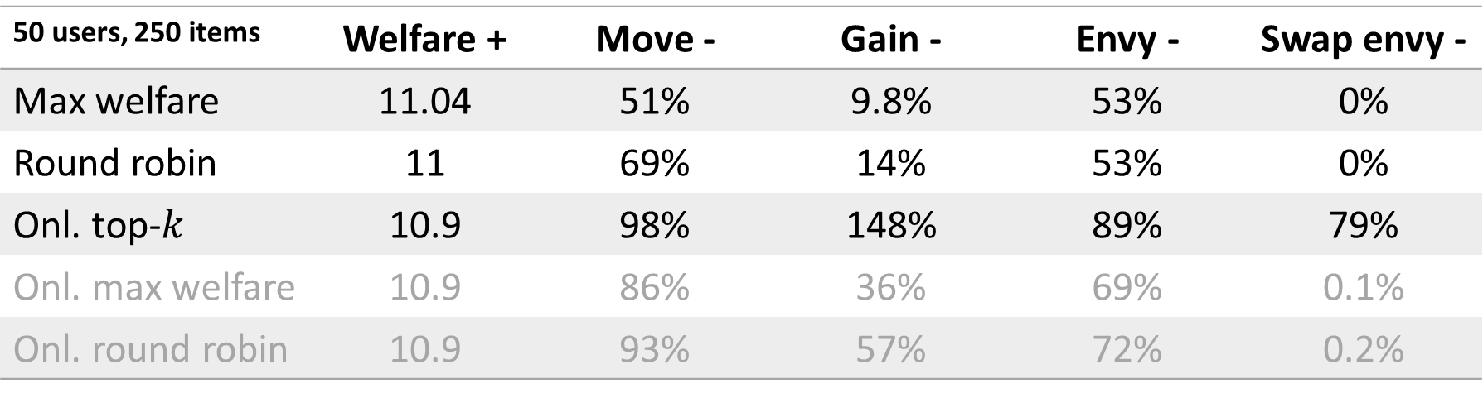
Results – Rent the runway
50 users, 250 items | Welfare + | Move - | Gain - | Envy - | Swap envy -
Max welfare | 11.04 | 51% | 9.8% | 53% | 0%
Round robin | 11 | 69% | 14% | 53% | 0%
Onl. top-$k$ | 10.9 | 98% | 148% | 89% | 79%
Onl. max welfare | 10.9 | 86% | 36% | 69% | 0.1%
Onl. round robin | 10.9 | 93% | 57% | 72% | 0.2%
*Similar results on other datasets, other instance sizes
Notes:
Move – all have > 50% participating in BP
Gain – much less incentive to deviate for round robin and Max welfare
Welfare – of course higher, not by much
Envy – significant fraction of buyers have envy for all algs, but can eliminate single swaps for RR/MW
0 given by theory for RR

Slide 22
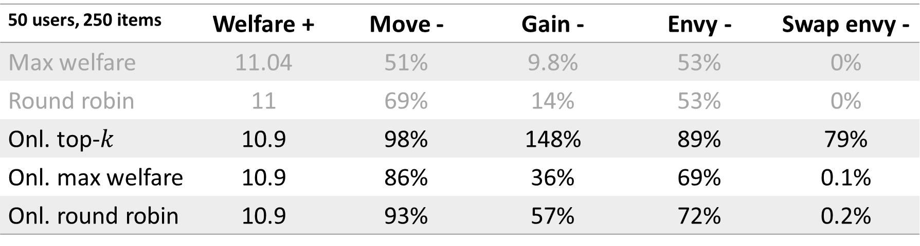
Results – Rent the runway
50 users, 250 items | Welfare + | Move - | Gain - | Envy - | Swap envy -
Max welfare | 11.04 | 51% | 9.8% | 53% | 0%
Round robin | 11 | 69% | 14% | 53% | 0%
Onl. top-$k$ | 10.9 | 98% | 148% | 89% | 79%
Onl. max welfare | 10.9 | 86% | 36% | 69% | 0.1%
Onl. round robin | 10.9 | 93% | 57% | 72% | 0.2%
*Similar results on other datasets, other instance sizes
Notes:
Move – all have > 50% participating in BP
Gain – much less incentive to deviate for round robin and Max welfare
Welfare – of course higher, not by much
Envy – significant fraction of buyers have envy for all algs, but can eliminate single swaps for RR/MW
0 given by theory for RR

Slide 23
Are recommender system markets stable?
Without exposure constraints – information goods
Top-$k$ recommendations are stable, envy-free and welfare optimal
Wishlist:
A clean characterization of stability, efficient algorithms for stable recs
Guidance: Is stability the right notion of 2-sided fairness to use here?
With exposure constraints – physical goods, ad contracts
Stable recommendations need not exist
Maximizing buyer welfare
Provably stable sometimes, small incentive for sellers to deviate in experiments
Credits: wikipedia, C Stewart on unsplash, maakyzz & rawpixel.com on FreePik

Slide 24


